Slide 1
Chipbin Solution Blueprint Template Version 1.0

Slide 2
1.0 Chipbin Mobile App Design
Context-
Chipbin is an smart mobile application will be used by NGOs in Bangalore to effectively collect waste from the facilities where the smart garbage bins are deployed with sensors.
This mobile application provides optimal route in collecting the waste in a very efficient ways using optimal algorithm and also provides effective visualization of garbage fill/humidity trends across different locations in the city
Solution-
Business requirements were compared against various key technologies and Ionic framework and Godaddy services has been leveraged for mobile backend.

Slide 3
Contents
Introduction
Solution Blueprint
Key Assumptions

Slide 4
Introduction
The Solution Blueprint is a product-oriented, high-level view of the solution that spans application, business process and technology,. It is used to identify and organize the logical units of work that will be performed during the project.

Slide 5
Contents
Introduction
Solution Blueprint
Key Assumptions

Slide 6
Solution Blueprint Diagram
ChipBin
1.0 Application
2.0 Technical
Architecture
3.0 Business Process
4.0 Operation Architecture
ChipBin
Presentation Tier
Update Master data
(Bin,User,garbage)
Update sensor data to Database on regular intervals
Search/
View
Optimal Route
Authentication
Google and facebook APIs
Application Tier
Go Daddy
Database Tier
View Bin Details
Go Daddy
View Analytical Charts

Slide 7
1.0 Application Map

Slide 8
2.0 Technical Architecture

Slide 9
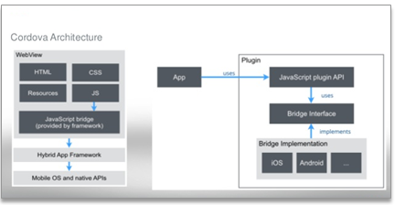
2.1 Technical Architecture Description
2.1 Presentation Layer:
Ionic Framework used for building the complete mobile app and goDaddy has been leveraged for mobile backend.Fusion charts has been utilized for visualization.
Ionic is an HTML5 mobile app development framework targeted at building hybrid mobile apps.
Ionic is modeled on popular native mobile development SDKs, making it easy to understand for anyone that has built a native app for iOS or Android.
Ionic has been designed to work and display beautifully on all current mobile devices.
Performance is good due to minimal DOM manipulation
Ionic apps are meant to run in the low-level browser shell like iOS’s UIWebView or Android’s WebView, which are wrapped by tools like Cordova/PhoneGap.

Slide 10
2.1 Technical Architecture Description
2.2 WebService:
This application has integration points to google maps API,facebook & google APIs.
Google Maps API: (Minimum Spanning Tree Algorithm)
Google maps API has been used for searching bin locations. Minimum spanning tree heuristic Prim’s Algorithm has been leveraged for optimal route calculation suits. This algorithm works best when the starting and ending are not fixed.
There is no limit to the number of garbage bins for any route search with this algorithm.
The time complexity is O(V^2). ,
Where e is edges and V is vertex
Facebook API/Google API:
Authentication features are provided using Oauth functionality(ng-cordova) to Facebook and Google API for this mobile application.

Slide 11
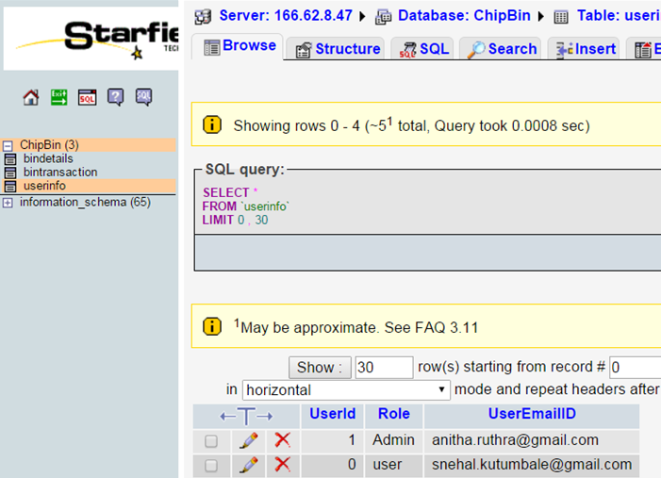
2.1 Technical Architecture Description
2.3 DatabaseTier
Data for the mobile application is fetched through calls to database tier deployed on the goDaddy domain.
PHP admin in goDaddy has been utilized to connect to MySQL database
Refer below screenshot of database from godaddy site used for the mobile application.

Slide 12
2.2 Key Technology Decisions
The following are the key technology decisions made for the mobile application.
1. Ionic Framework.(Advanced HTML5 Hybrid Mobile App Framework)
2. goDaddy for mobile backend (MYSQL).
3. Google Map API with Minimum spanning tree algorithm to give optimal route.
4. Fusion charts with Angularjs/Jquery has been used for charts and Graphs.

Slide 13
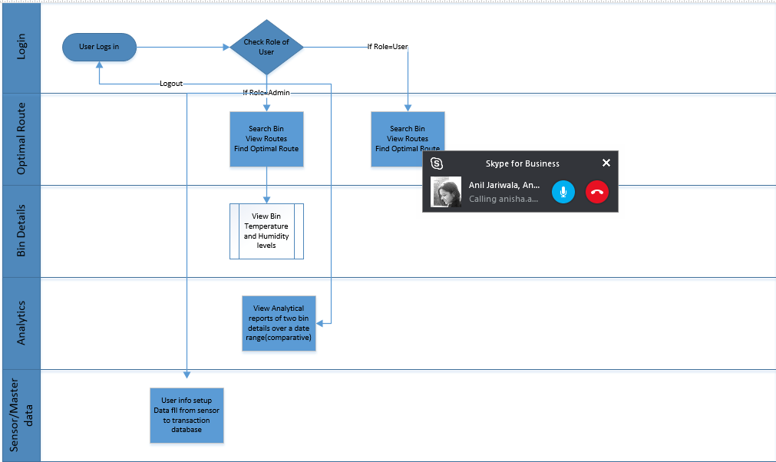
3.0 Business Process Description

Slide 14
Contents
Introduction
Solution Blueprint
Key Assumptions

Slide 15
Key Assumptions
Data from garbage bin sensors will be loaded in the database through separate service/batch jobs/web service calls
15
11/1/2015 7:18 PM

